Slide 1
Leadership & Technology
Matthew White
Notes:
Are your classroom colors different than what you see in this template? That’s OK! Click on Design -> Variants (the down arrow) -> Pick the color scheme that works for you!
Feel free to change any “You will…” and “I will…” statements to ensure they align with your classroom procedures and rules!

Slide 2
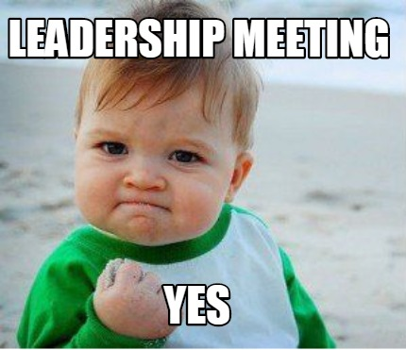

Slide 3
Technology

Slide 4
Technology & Leadership

Slide 6
Binge Watchers Anonymous

Slide 7
“The art of communication is the language of leadership.”
James Humes (Speechwriter for five Presidents)

Slide 8
How Do You Communicate?
Commission
Board
Members
Chapter
Board
Members
Region
Chapter Presidents
Members

Slide 9
Member Communication (One Way)
Email (maybe opt-in or opt-out)
AFC Blast (opt-out)
Remind.com (opt-in)
Facebook Page (opt-in)

Slide 10
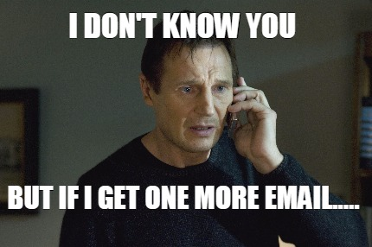

Slide 11
E-Blast

Slide 13
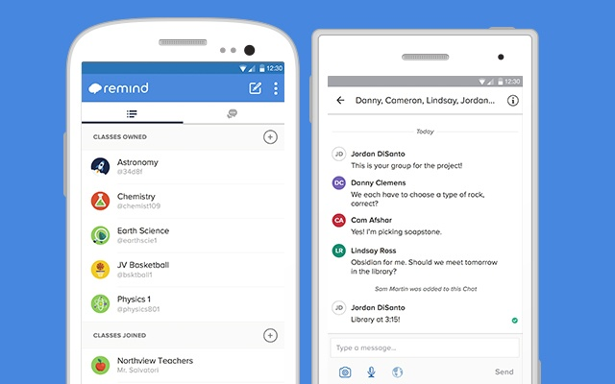

Slide 14
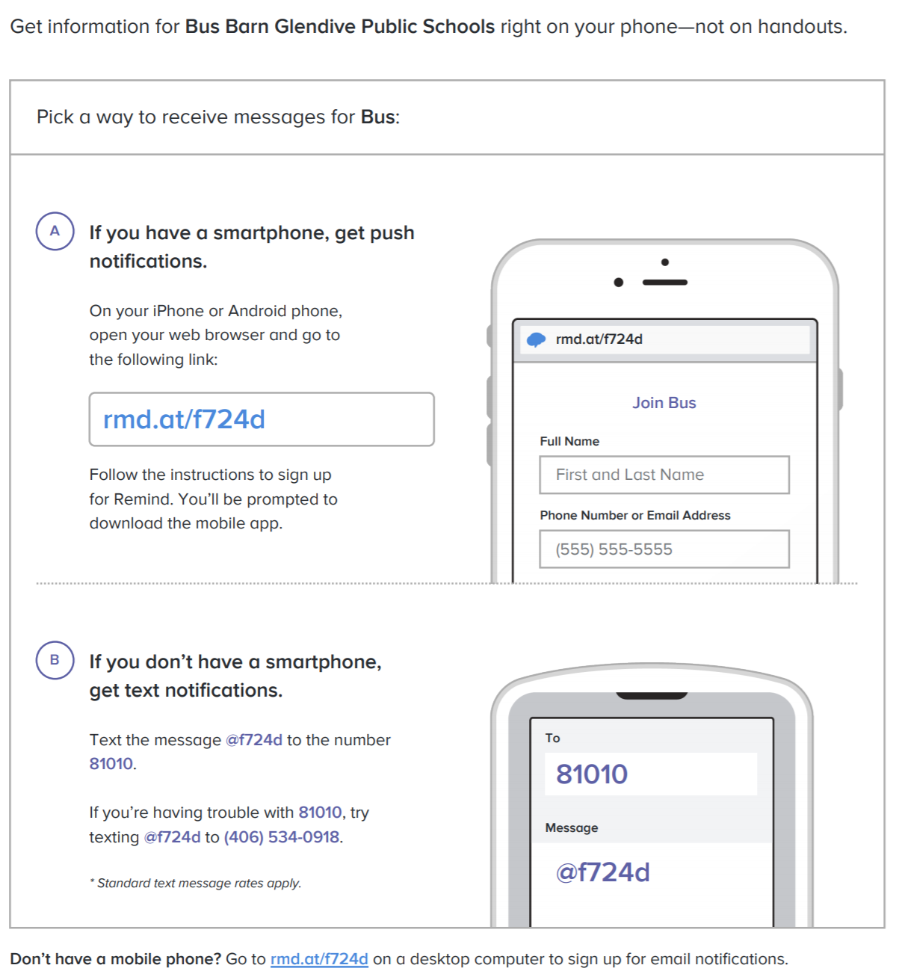

Slide 16
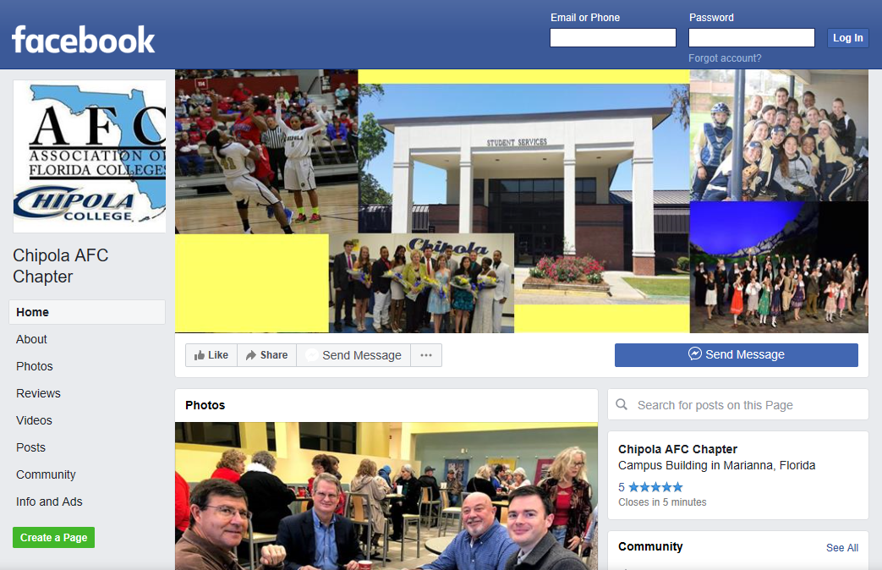

Slide 17
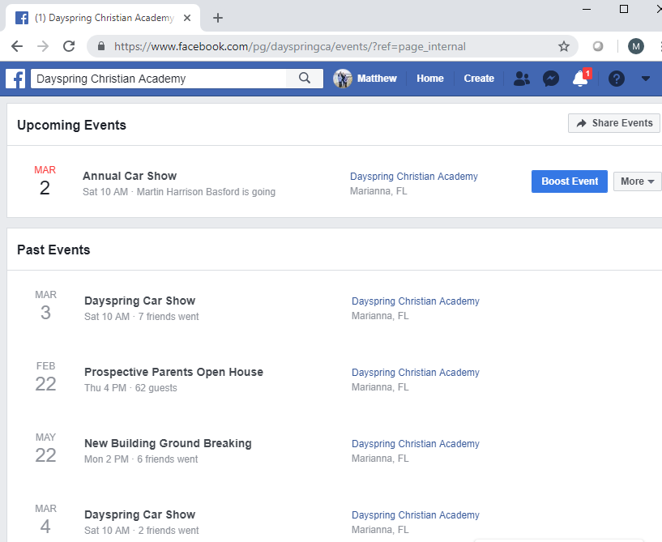

Slide 18
Combine Methods
E-Blast/Email/FB Page +

Slide 19
Board Communication (Two Way)
Email
Group Text
Facebook Group
GroupMe.com

Slide 20
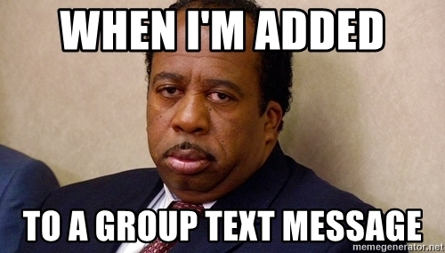

Slide 23
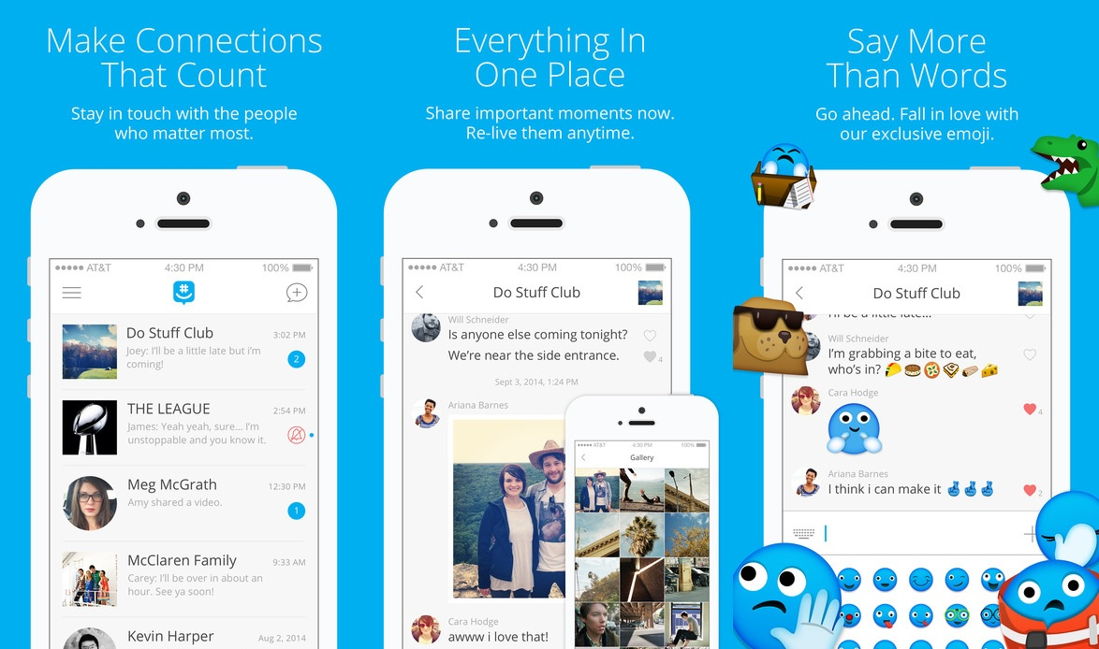

Slide 24
What have you found that works best for communication?
Commission
Board
Members
Chapter
Board
Members
Region
Chapter Presidents
Members

Slide 26
Technology with a Purpose
Technology should make people’s lives easier (although this is often far from the norm), as well as more productive and more fulfilling.

Slide 27
Questions?

