Slide 1


AFC Webinar Series:
Using the Fish Philosophy for Virtual Team Building

Slide 2
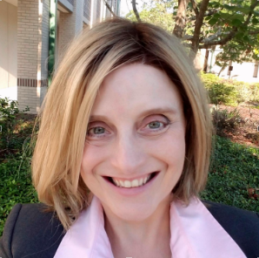
Facilitator
Christine Smith
Associate Dean of E-Learning and Instructional Technology (EIT)
Pasco Hernando State College
smithc@phsc.edu
727.816.3769

Slide 3
Webinar Details
Is your team telecommuting now?
How do you remain "present" for each other during this time?
PHSC has used the Fish Philosophy to promote team building and have carried this philosophy online.
Learn how we incorporated the four aspects of fish during this uncertain time.
Let’s brainstorm some ideas you can use with your virtual team!

Slide 4
Resource Links
Webinar Link
https://us02web.zoom.us/j/82714532391?pwd=dDl4cG9oS1U2b24zM2dNbnYyQXdNUT09
Seattle Fish Market
https://www.youtube.com/watch?v=_AAQT6ifGys

Slide 5
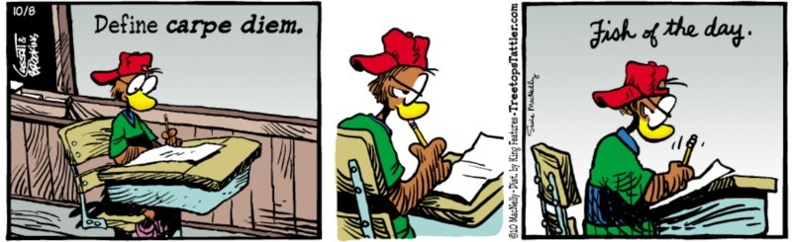

Slide 6


Take Action!
Fish
Tell Story – Track Narrative – Journal
Strong Verbs - Play, Engage, Support, & Choose
Friendly Competition
Collaborative Technology
  Zoom, Padlet, OneDrive, Teams, Email

Slide 7

Digital Storytelling
Newsletter
PHSC E-Learning and Instructional Technology Facebook https://www.facebook.com/EITPHSC
PHSC E-Learning and Instructional Technology Twitter https://twitter.com/EITPHSC?fbclid=IwAR2koiwCF6WgZoJPP575loyP-Z6oHg7UwxqCxQ7CPmuBlgijcwZbM3W3pDI
Fish Philosophy Twitter
https://twitter.com/fishphilosophy

Slide 8
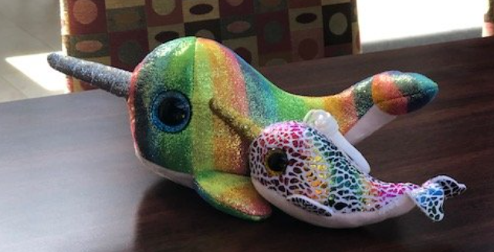
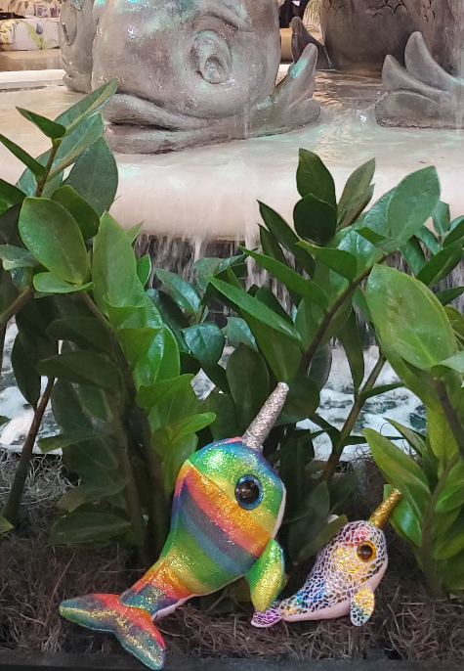
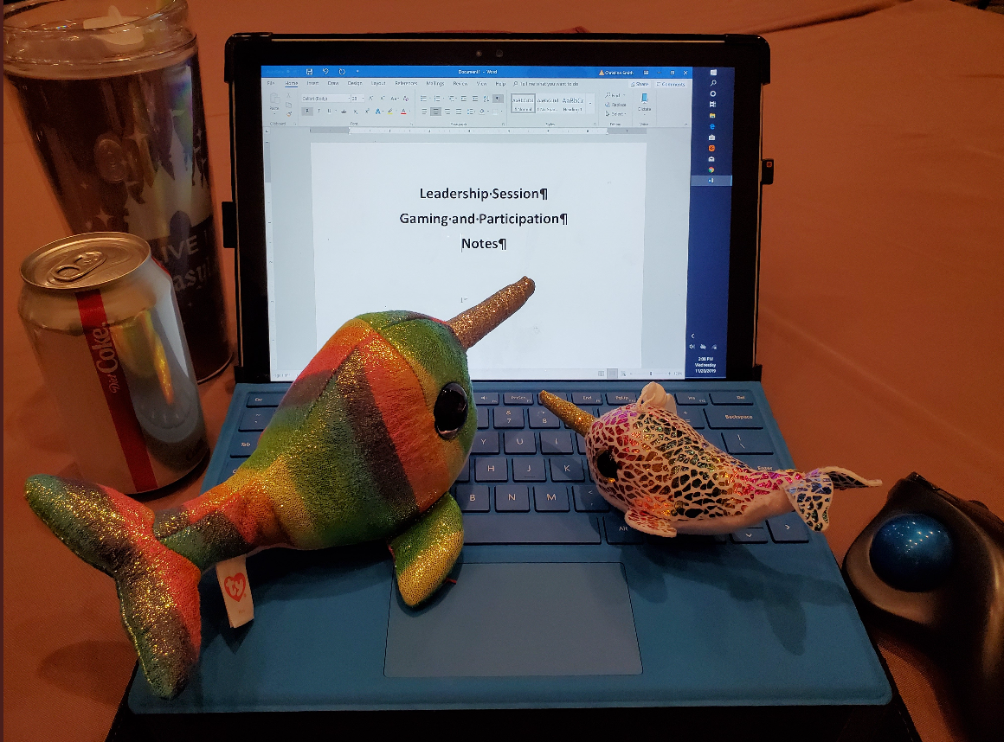
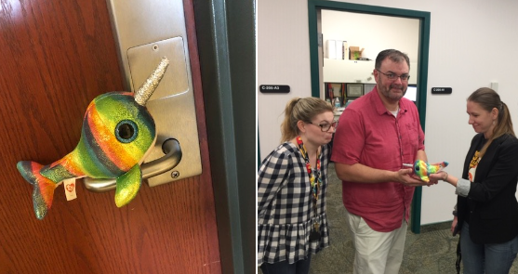
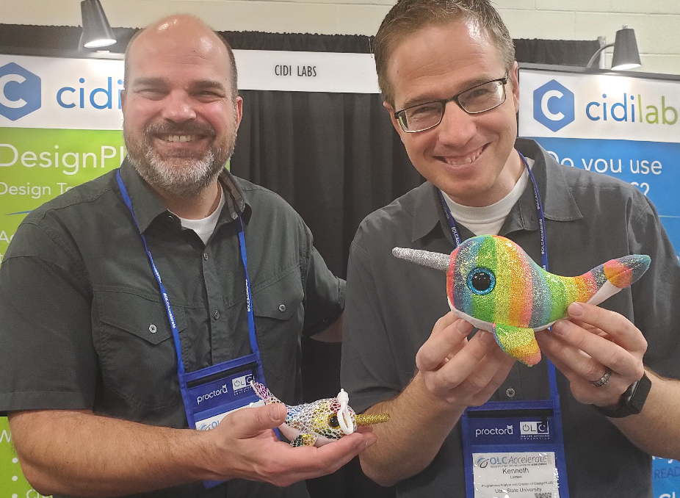
The Adventures of Nova and Nori

Slide 9
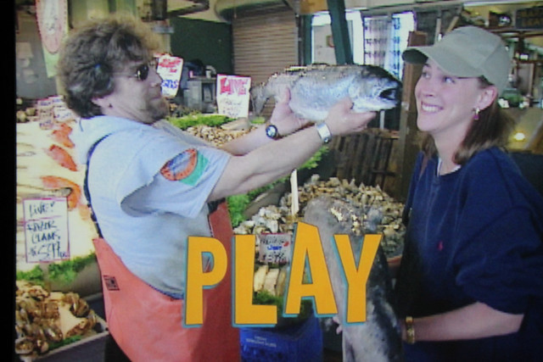
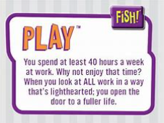

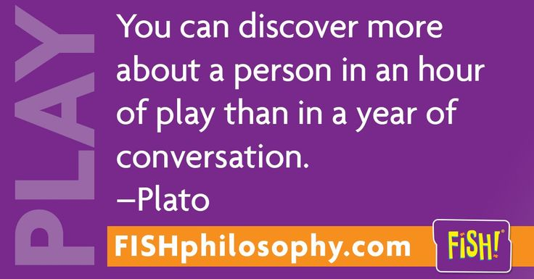

Slide 10
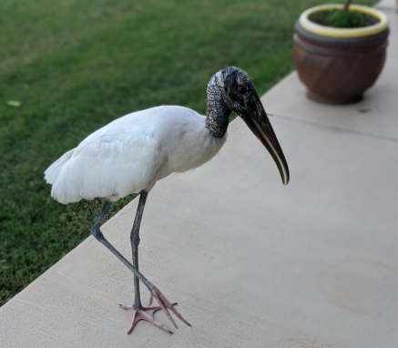
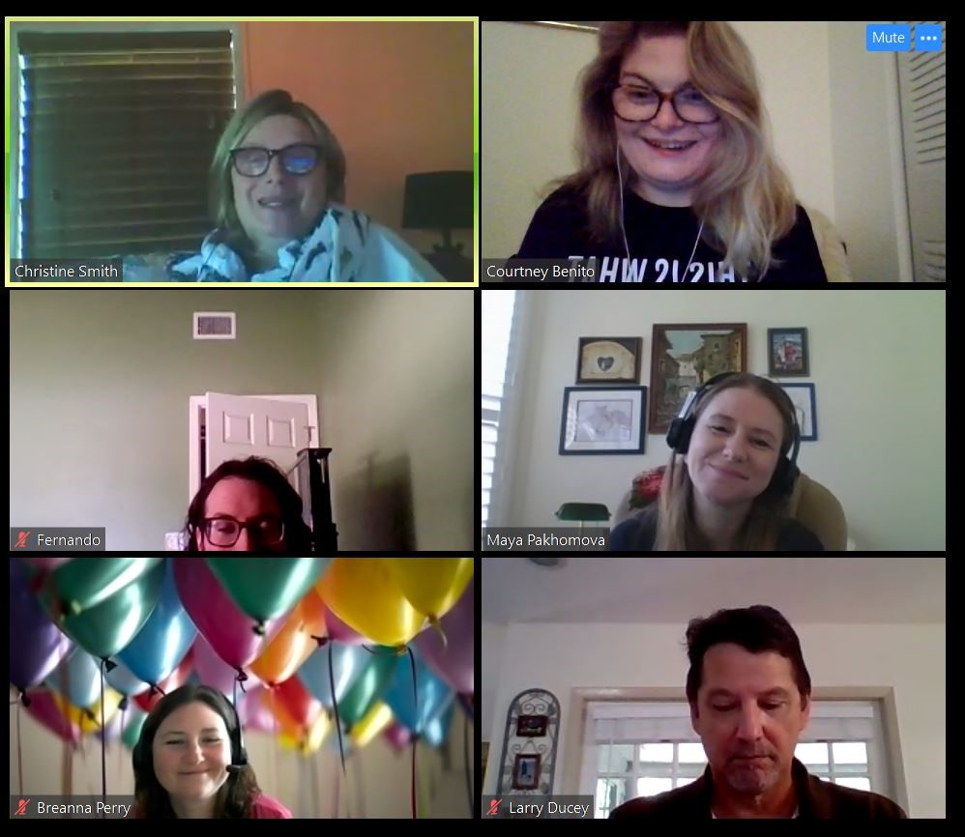
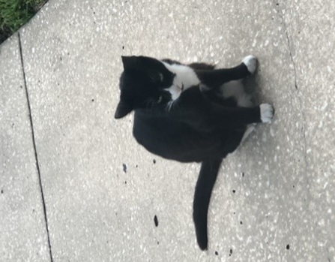
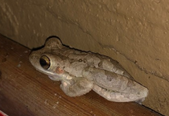
Play
Maintain spirits through Play
We are in a marathon now
Think about play differently
Ideas
  Weekly Email Participation – Who is your new Recruit?
  Zoom
  Who wants to be a Mayallionaire

Slide 11
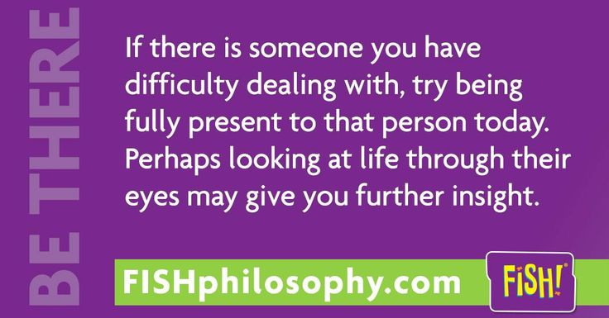

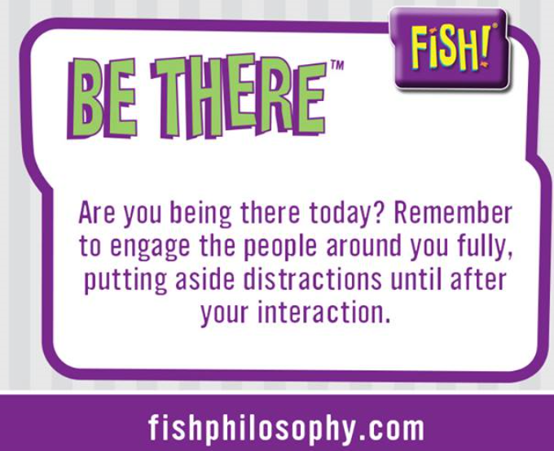
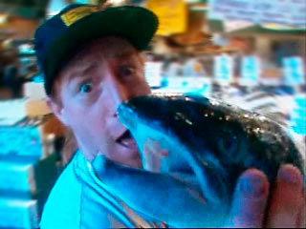
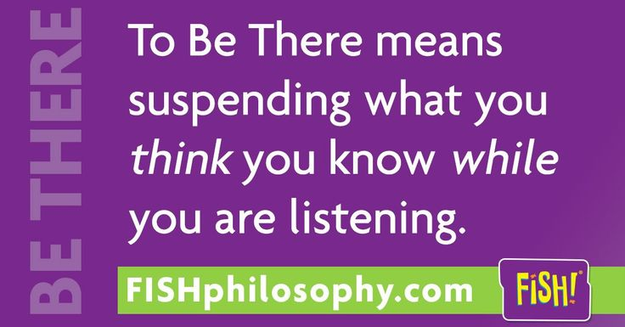

Slide 12

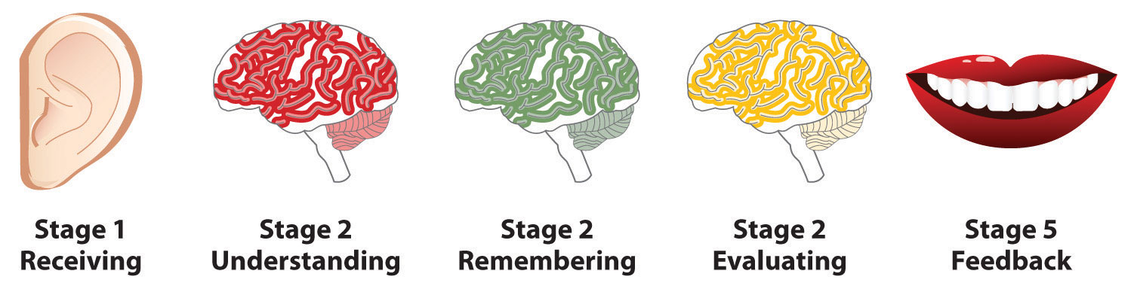
Be There
Listen
Hear
Engage
Attentive
Be There for:
    SELF!
    Colleagues
    Faculty
    Students

Slide 13


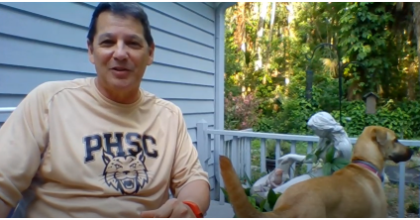

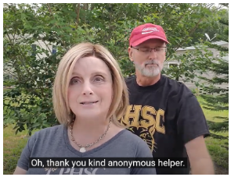
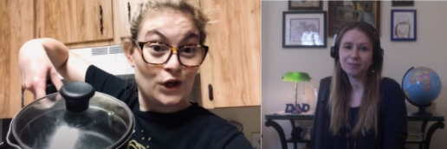
Be Where? Be there!
Kickin’ it Old School
Videos
Mission Control Course
Support
Take a break
Secret Buddy

Slide 14

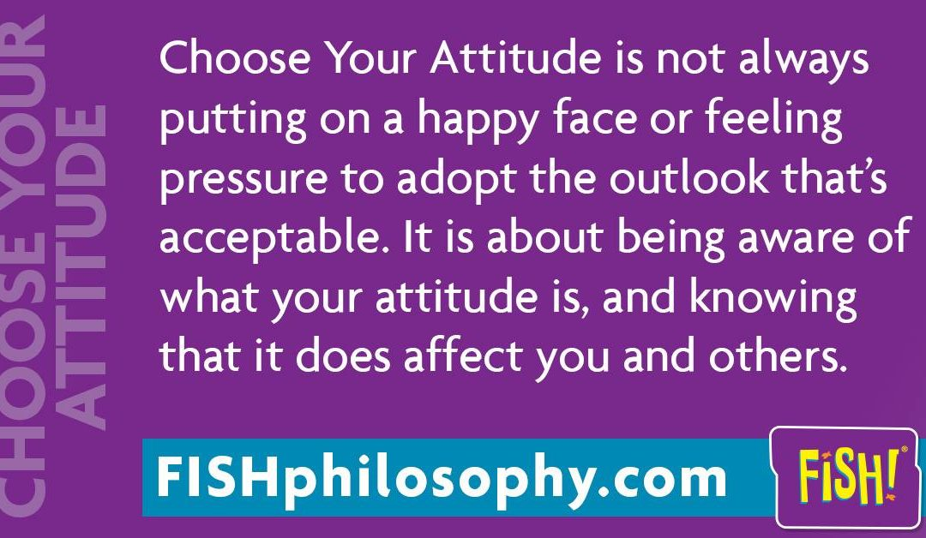
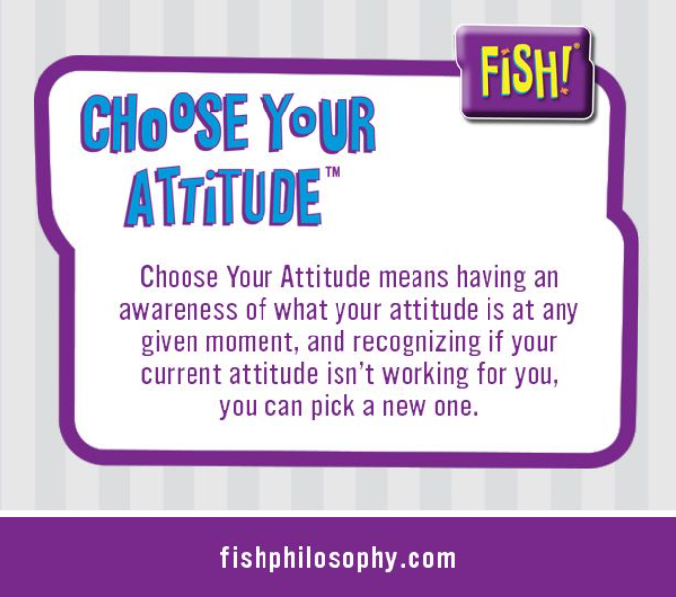
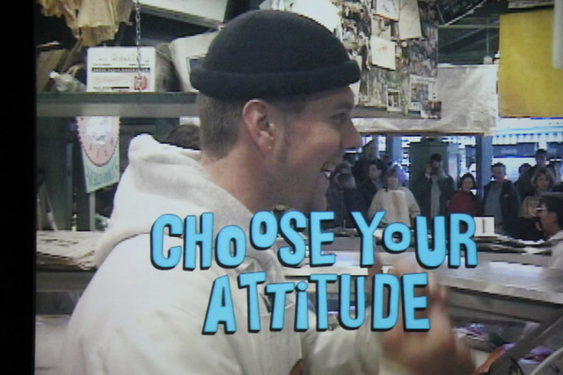
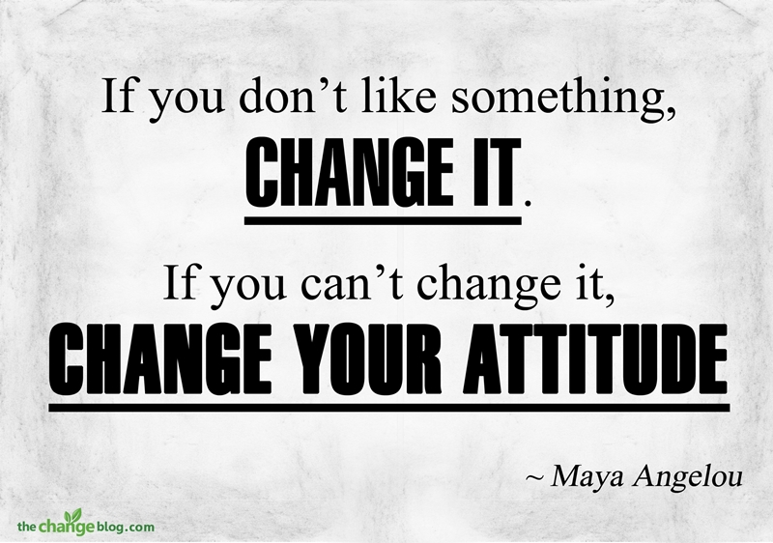

Slide 15

Choose Your ‘Tude Dude ☺
QUESTIONS FOR THE GROUP
  How can you build an awareness of your attitude?
  Which attitude would you choose? What attitude do you wish a colleague chose?
  Hallway/bridge conversations are no longer commonplace. How can we replicate that?
PRELOAD YOUR ATTITUDE
  Review schedule
  Choose Words
  Write up a Quick Reference
  Tape to your monitor
BRING YOUR BEST SELF TO WORK
  Put on work clothes
  Clock in before boss ☺
  Daily schedule
  Take lunch !

Slide 16
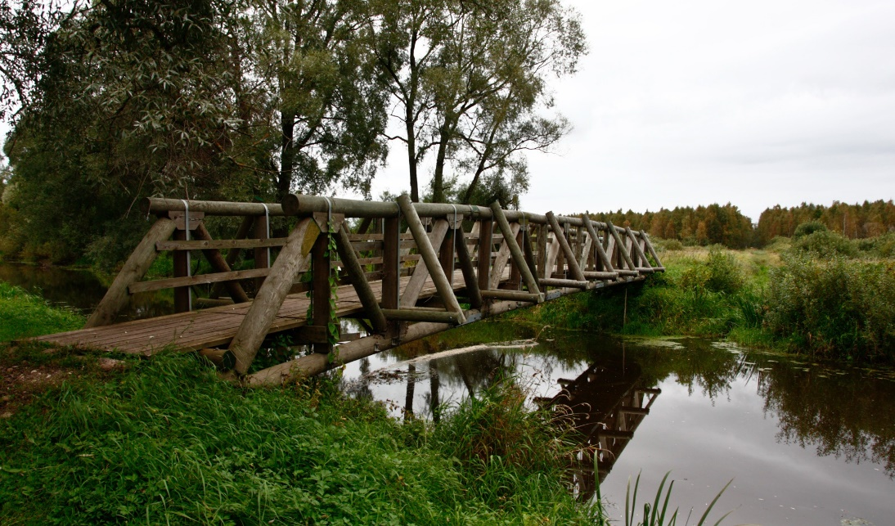

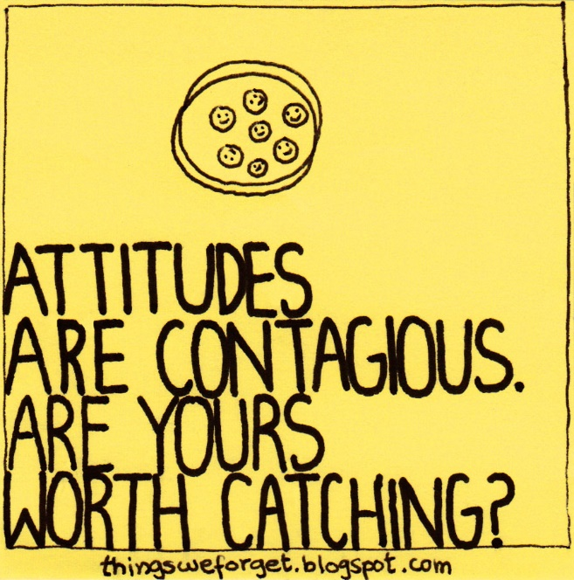
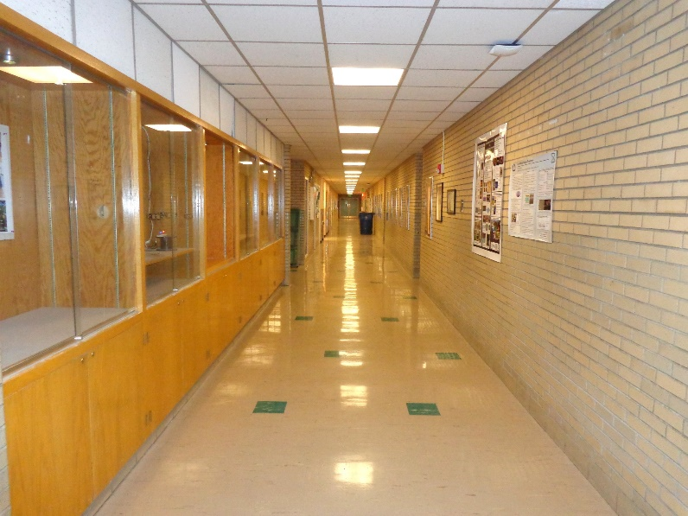
Choose Your ‘Tude Dude ☺
QUESTIONS FOR THE GROUP
  How can you build an awareness of your attitude?
  Which attitude would you choose? What attitude do you wish a colleague chose?
  Hallway/bridge conversations are no longer commonplace. How can we replicate that?

Slide 17
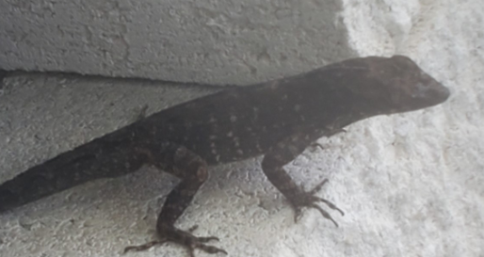

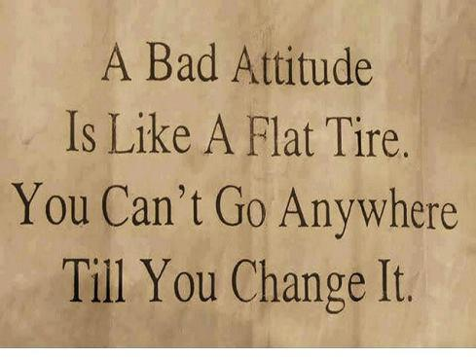
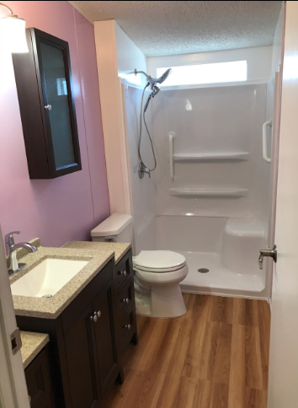
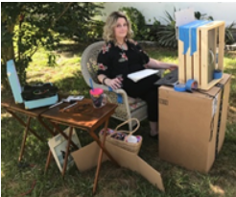
What did EIT Do?
Email Campaign
  Send inspirational quote
  “new recruit picture”
Change your location and
change your attitude
Get busy doing for others
Network Outside College
Work with Students

Slide 18
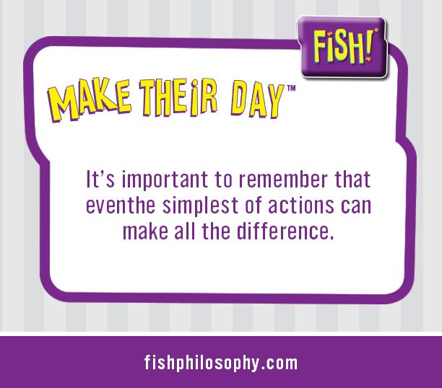
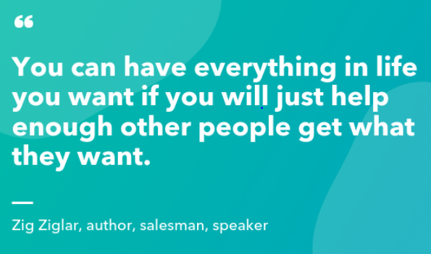

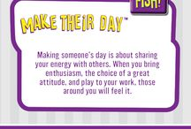

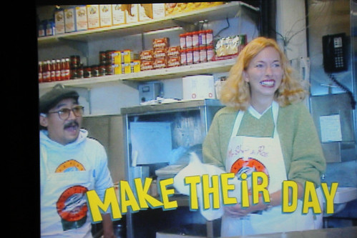

Slide 19
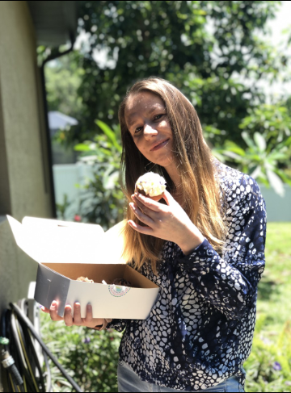
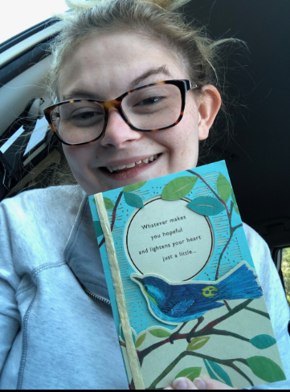
Making their day ideas
Find that “Oscar the Grouch” and make a gesture to turn that person’s day around
Be inclusive
Remember birthdays, anniversaries, and so on
Send cards
Send cupcakes
Energizing to think of others inspires that same energy in others.
Thank you notes
Kudos in newsletter

Slide 20




Make Their Day = Make a Difference
Action Plan
Key words – Curious and Interested
Choose Three People (Who is is rarely acknowledged?)
  What people like?
  What are they interested in?
  Favorite lunch spot
  Hobbies?
  Birthday?
  WHAT ARE THEY PROUD OF?

Slide 21
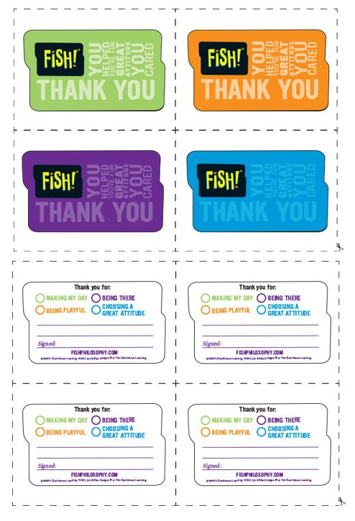

Slide 23


Slide 24
Links
https://www.youtube.com/watch?v=_AAQT6ifGys
https://www.facebook.com/EITPHSC
https://twitter.com/EITPHSC?fbclid=IwAR2koiwCF6WgZoJPP575loyP-Z6oHg7UwxqCxQ7CPmuBlgijcwZbM3W3pDI
https://twitter.com/fishphilosophy
https://padlet.com/smithc145/rount8rgl7x9trv0

Slide 25
